Slide 1


BIOMECHZOO: AN OPEN-SOURCE MOVEMENT ANALYSIS TOOLBOX FOR MATLAB
Philippe C. Dixon¹, JJ Loh², Yannick Michaud-
Paquette³, and David J. Pearsall³
¹Department of Engineering Science, University of Oxford, Oxford, UK
²Medicus Corda. Montreal, Canada
³Department of Kinesiology, McGill University, Montreal, Canada

Slide 2

Presentation outline
Describe some general data processing problems
Introduction to the key features of biomechZoo
Use biomechZoo to process sample data set (practice session!)
Intended users:
Novice programmers or persons new to biomechanics
Expert users wishing to add/improve content

Slide 3
Data Processing
1

Slide 4
Data Processing: Approaches
Example of bad approaches
“ I need to calculate the min knee angle, it’s easy. I open each trial in Vicon, find the point on the curve, and enter it into an excel sheet sorted by condition – I’ve only had to repeat this 500 times, oh wait I actually wanted the max…”
“I had a massive script to process my thesis – it was amazing. I’m working on a new project now and am building a new crazy script, it’s totally different”
Characteristics of efficient processing:
Logical / clear
Largely automated
Generalizable to new data or research projects

Slide 5
Data Processing: Predict your needs
Key features of typical biomechanical data
Multiple conditions/groups assessed
Numerous trials are collected
Trials contains multiple channels
Each channel contains a large number of data points recorded over a time interval
Notes:
itions/groups are assessed
Numerous trials are collected
Each trial contains multiple channels (sometimes from different devices)
Each channel contains a large number of data points

Slide 6
Data Processing: Predict your needs
Standard processing steps
Raw data
Compute quantities
Display
Statistically Analyze

Slide 7
biomechZoo
2

Slide 8
biomechZoo: Background
First developed by Loh (2004)
Used to process data from numerous papers (15 and counting)
Based on two simple tenants:
-Avoid repetitive (manual) tasks
-Strive for parsimony
Implemented in Matlab
Latest updates (v1.3) available at www.biomechzoo.com

Slide 9
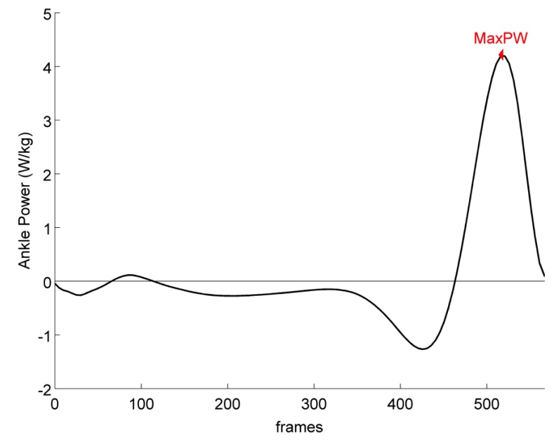

biomechZoo : Files and structure
Each branch is made up of “line” and “event” subfields
- Line: contains actual data
vector
- Event contains info about a
point
An additional channel “Zoosystem” contains meta information about the trial (e.g. Anthropometrics, diagnosis, date collected)

Slide 10
biomechZoo : Processing overview
Raw data
Compute quantities
Display
Analyse
Convert to zoo
Append zoo file
biomechZoo allows you to navigate these steps with (relative) ease

Slide 11
Practice session
3

Slide 12
biomechZoo : Practice session
We will explore the main features of the zoosystem through a hypothetical study
Load biomechZoo (run startZoo located in the root biomechZoo folder) on your computer and type ‘help zoo_process_example.m’
The’ zoo_process_example’ m-file explains the steps.*
The data associated with this study are found in the sample data repository (requires separate download of Biomechzoo-samplestudy)’
* User’s should be familiar with Matlab basics before attempting the practice session.

Slide 13

Thank you / Questions?
Download at: www.biomechzoo.com
main contact: philippe.dixon@gmail.com
If used in the preparation of your manuscript, please reference:
Dixon PC, Loh JJ, Michaud-Paquette Y, Pearsall DJ. The Zoosystem: An Open-Source Movement Analysis Matlab Toolbox. Proceedings of the 23rd meeting of the European Society of Movement Analysis in Adults and Children. Rome, Italy .Sept 29-Oct 4th 2014.

